Slide 1
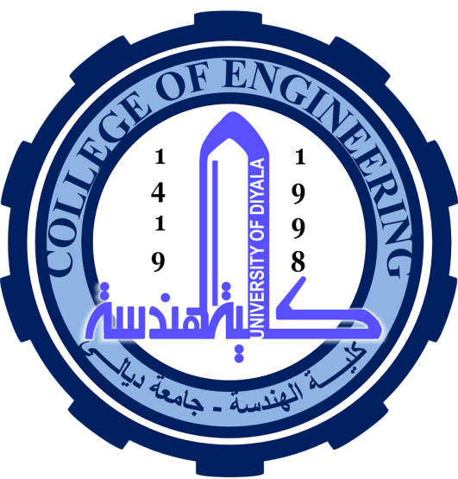
University of Diyala
College of Engineering
Department of Electronics Engineering
Course Number: U103
Course Name: Computer Science
Lecture (1)
Asst. Lect. Wurod Qasim Mohamed

Slide 2
Computer is a device that transforms data into meaningful information. Data can be anything like marks obtained by you in various subjects. It can also be name, age, sex, weight, height, etc. of all the students in a class. Computer can also be defined in terms of functions it can perform.
A computer can
accept data
store data
process data as desired
retrieve the stored data as and when required
print the result in desired format.
The major characteristics of a computer are high speed, accuracy, diligence, versatility and storage.

Slide 3
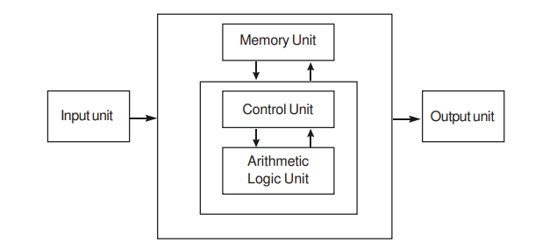
Block diagram of Computer Organization

Slide 4
We discuss below each of these operations.
Input: this is the process of entering data and programs into the computer system.
Control Unit (CU): The process of input, output, processing and storage is performed under the supervision of a unit called 'Control Unit'. It decides when to start receiving data, when to stop it, where to store data, etc. It takes care of step -by-step processing of all operations inside the computer.
Memory Unit: Computer is used to store data and instructions.
Arithmetic Logic Unit (ALU): The major operations performed by the ALU are addition, subtraction, multiplication, division, logic and comparison.
Output: This is the process of producing results from the data for getting useful information.
The ALU and the CU of a computer system are jointly known as the central processing unit (CPU). You may call CPU as the brain of any computer system

Slide 5
PERIPHERAL DEVICES
Peripheral devices are connected to the computer externally. These devices are used for performing some specific functions. Peripheral devices are as follows:
Input Devices
Output Devices
Other Peripherals

Slide 6
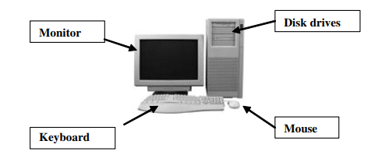
Different peripheral devices of Computer

Slide 7
INPUT DEVICES
Input devices accept data and instructions from the user. Following are the examples of various input devices, which are connected to the computer for this purpose.
Keyboard: is the most common input device. Several kinds of keyboards are available, but they resemble each other with minor variations. The keyboard in most common use is the QWERTY board. Generally standard keyboard has 104 keys. In these keyboards, the cursor control keys are duplicated to allow easier use of the numeric pad.
Mouse: is an electro-mechanical, hand-held device. It is used as a pointer. It can perform functions like selecting menu commands, moving icons, resizing windows, starting programs, and choosing options.
Light Pen: utilizes a light-sensitive detector to select objects on a display screen. A light pen is similar to a mouse (as shown in figure 1.5), except that with a light pen you can move the pointer and select objects on the display screen by directly pointing to the objects with the pen.
Optical/magnetic Scanner: are used for automatic data collection. An image scanner translates printed images into an electronic format that can be stored in a computer’s memory.

Slide 8
5. Touch Screen: displays and pads are now being offered as alternatives to keyboard. Here the input can be given through the computer screen, that accepts the input through monitor; users touch electronic buttons displayed on the screen or they may use light pen.
6. Microphone for voice as input: which takes voice as input. The voice communication is more error-prone than information through keyboard. There are two types of microphones available 1. Desktop Microphone 2. Hand held Microphone.
7. Trackball: a pointing device, is a mouse lying on its back

Slide 9
OUTPUT DEVICES
Output devices return processed data that is information, back to the user. Some of the commonly used output devices are:
Monitor (Visual Display Unit): is perhaps the most important output device because people interact with this device most intensively than others. Two basic types of monitors are used with microcomputers, which are as follows:
Cathode Ray Tube (CRT): CRT or Cathode Ray Tube Monitor is the typical monitor that you see on a desktop computer. It looks a lot like a television screen, and works the same way. This type uses a large vacuum tube, called cathode ray tube (CRT).
Liquid Crystal Displays (LCD): This type of monitors are also known as flat panel monitor. Most of these employ liquid crystal displays (LCDs) to render images. These days LCD monitor are very popular.

Slide 10
2. Printers: After a document is created on the computer, it can be sent to a printer for a hard copy (printout). Some printers offer special features such as colored and large page formats. Some of the most commonly used printers are:
A laser printer produces high quality print that one normally finds in publishing. It is extremely fast and quiet.
An ink-jet printer creates an image directly on paper by spraying ink through as many as 64 tiny nozzles. Although the image it produces is not generally quite as sharp as the output of a laser printer, the quality of ink-jet images is still high.
The dot matrix printer was very popular at one point of time. Its speed is measured in characters per second (CPS). Although it is less expensive, it is louder, slower and produces lower print quality.
A line printer is generally used with large computer systems to produce text based data processing reports.
3. Plotter: is a special kind of output device that, like a printer, produces images on paper, but does so in a different way. Plotters are designed to produce large drawings or images, such as construction plans for buildings or blueprints for mechanical objects. A plotter can be connected to the port normally used by a printer.
4. Speakers: are another type of output device, which allow you to listen to voice like music, and conversation with people.

